Slide 1
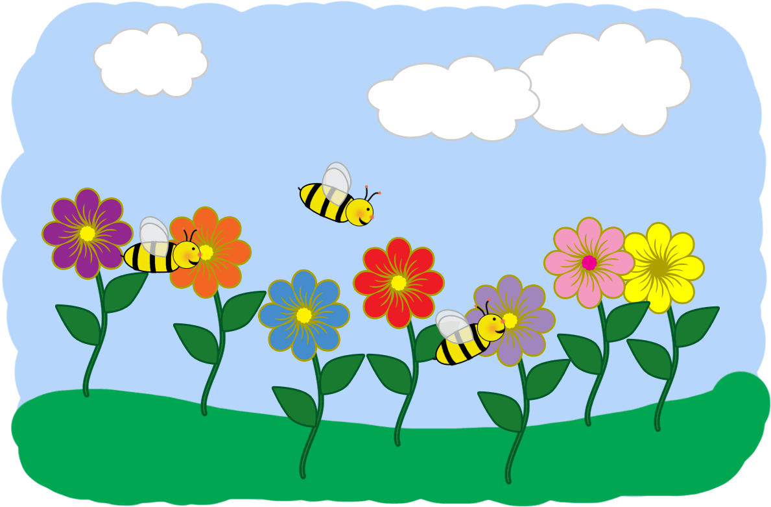
May
Ms. Diaz
K-12
What Are We Learning? Reading:
Estrellita:(Spanish)
(Spanish)
We are learning syllables with the I vowel
Fundations:(English)
(English)
We are learning about word families.
-op, -in, -at, -on, -ug
Writing
We are writing true stories about life events
Math
We are learning how to count, write, and represent numbers up 20
Science
We are learning all about weather
Social Studies
We are learning about Mexican culture
Connections Corner
Please log onto P.S. 376 website and click on to K-12 /Ms. Diaz for updates, homework and resources.
Important Dates
Trip dates
May 1, 2018 Prospect Park
May 2 2018 Flushing Meadows
May 9, 2018 Central Park zoo
May 16, 2018 Green Meadow Farm
Notes:
What are we learning this month?

Slide 2
Thank you for downloading my first TPT item! Please rate or message me if you like the newsletter.
<3 Megan
A HUGE thanks goes to mycutegraphics.com for all the graphics used. Font is Ammy’s Handwriting and can be found here: http://www.dafont.com/ammys-handwriting.font
AND
Background is an amazing product by Mel @ http://melstampz.blogspot.com

